Slide 1
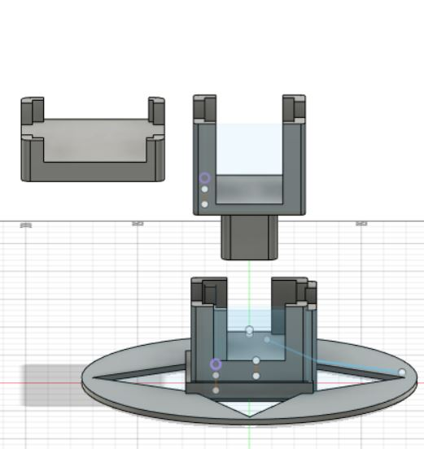
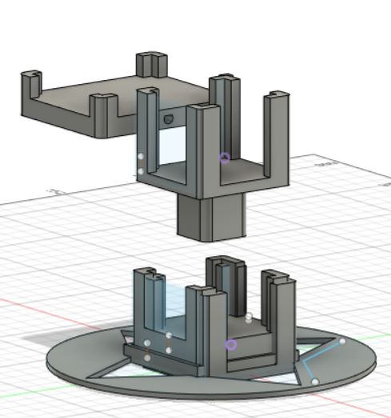
Mount:
Receiver module place in socket
Stand:
Stepper Motor in horizontal position placed in socket
Base:
Stepper Motor in vertical position placed in socket

